Slide 1
MATLAB for Scientists Introduction
Dr. Allison J. Lopatkin
1014 Altschul Hall
alopatkin@barnard.edu

Slide 2
Class introduction
Course overview
Group expectations

Slide 3

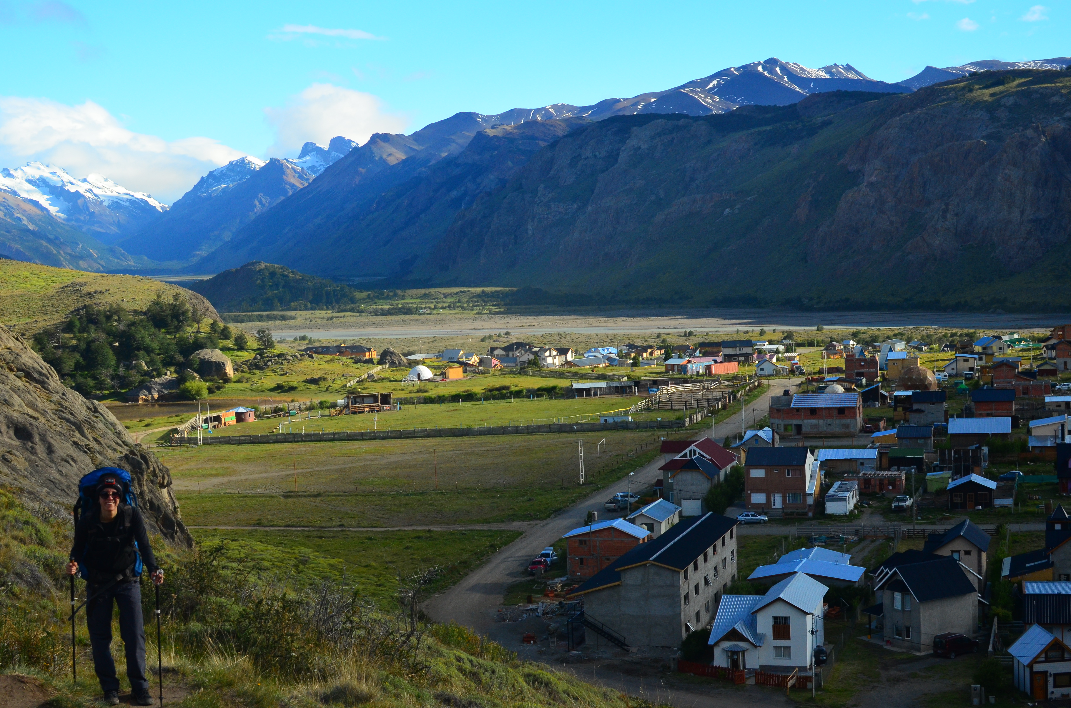
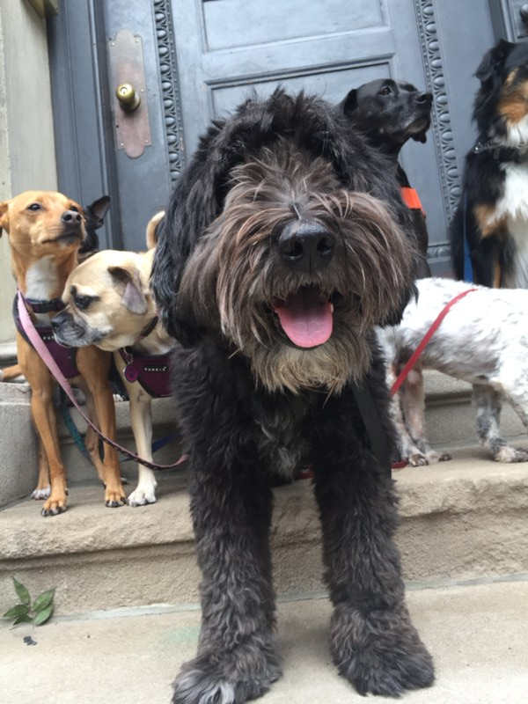

About me (she/her/hers)
Barney
Tiki

Slide 4
73.6% of all statistics are false
(including this one)

Slide 5
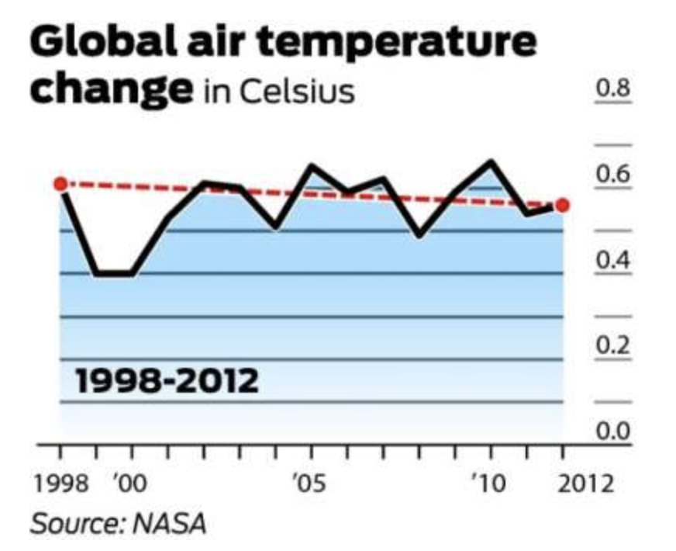
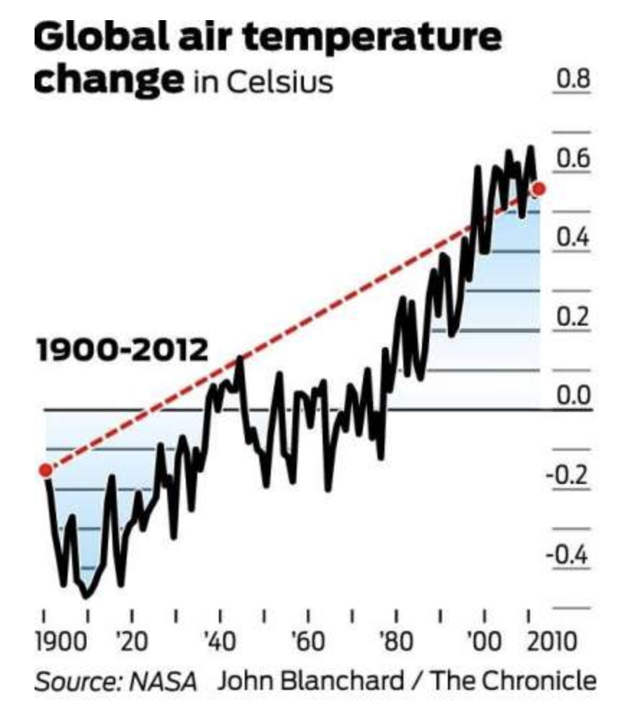
Cherry-picking data to distort trends
Degree change
Degree change

Slide 6
Improperly scaling data to distort trends
327,000 in 2013
2,007,371 in 2006
Cancer screening and prevention services
Abortions
289,750 in
2006
935,573 in 2013
Year
Year

Slide 7
Not all correlations are meaningful
Organic food sales
Individuals diagnosed
Years

Slide 8
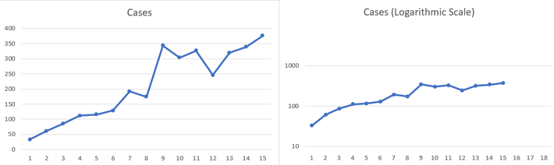
Misleading data has catastrophic consequences….
What’s wrong with this graph?

Slide 9
Why programming?
To correctly extract quantitative information from complex datasets, so that we can interpret biological meaning
Integrate diverse data types
Assemble different types of analyses into pipelines (throughput)
Analyze more data faster (automation)
Processing in an unbiased way (e.g., image analysis)
Standardize methods across scientific community

Slide 10
Programming in Biology
Genomics
Mathematical modeling (molecular, epidemiological)
Medical imaging analysis
Machine learning (biomarker discovery)
Molecule/drug design and discovery
Whole cell models/gene networks

Slide 11

What is MATLAB?
Handles tabular data
Quick, extensive, and professional data visualization
Comprehensive documentation
Debugging is easy with IDE
TONS of built-in functions
Individual toolboxes for add-on functionality
Consider MATLAB the gateway language!!

Slide 12
Course overview
This is not a course to trick you. It’s a course to teach you something concrete that you can walk away from knowing how to do
We will be starting from the absolute basics
You will walk away with a tangible skill
Directly applicable to other languages/jobs/research/etc
The full syllabus can be found on Canvas
Course website: https://github.com/ajlopatkin/matlab_for_scientists
Homework: 8 graded problem sets: 144 pts (16 pts each except HW7 which is double; 36%)
Exam 1: 50 pts (12.5%)
Exam 2: 50 pts (12.5%)
Final independent project: 100 pts total (25%)
Final report (professional code + paper): 85 pts
Final presentation: 15 pts
Class participation: 56 pts (2 pts per day; 14%)

Slide 13
How am I going to teach you MATLAB?
Slides will be color coded
Black is for general info

Slide 14
MATLAB-specific (functions or general)
Summary of MATLAB functions for a section of a lecture
You can expect a ‘functions’ slide before each section to introduce the functions that you need to know how to use

Slide 15
Important non-MATLAB contextual information
Blue slides indicate important background material that you need to know, but may not be specifically MATLAB related
For example:
Mathematical formulas
Definitions
Key explanations

Slide 16
All prof-lead in-class examples
Yellow slides indicate examples that follow concept introductions that we do as a class

Slide 17
Green slides indicate break-out group exercises (in person or over zoom)
Instructions provided on a slide-slide basis

Slide 18

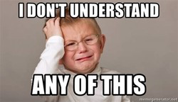
Programming can be hard!!!!....but it improves over time
What we want coding to be like:
What coding is actually like:
Set realistic expectations
Ask *ALL* questions that you have, always
Think of programming like a puzzle
More experienced coders should be mindful, respectful, and *helpful* to everyone else in the room

Slide 19
I can expect you to…
Come to class prepared and excited to learn MATLAB
Be respectful and inclusive to your peers
Maintain face coverings over both nose and mouth
Ask for help when you need it
During class
Office hours
By appointment, etc….
Complete and hand in assignments on time
Keep in mind that all examples, even if topically distant from your interests, teach concepts that are directly applicable
Persevere and work hard (that’s why participation so high!)

Slide 20
You can expect me to….
Come to class on time and prepared
Assign work that will teach you MATLAB in the most effective way
Challenge you so that you learn the material
Never busy work or purposely tricky
Answer every question (even if I don’t know the answer at the time)
Personally work with every single student to make sure they understand the material
Hold students accountable for assignments and classroom etiquette
Bring pictures of Tiki & Barney on days that will be long and hard

